Slide 1
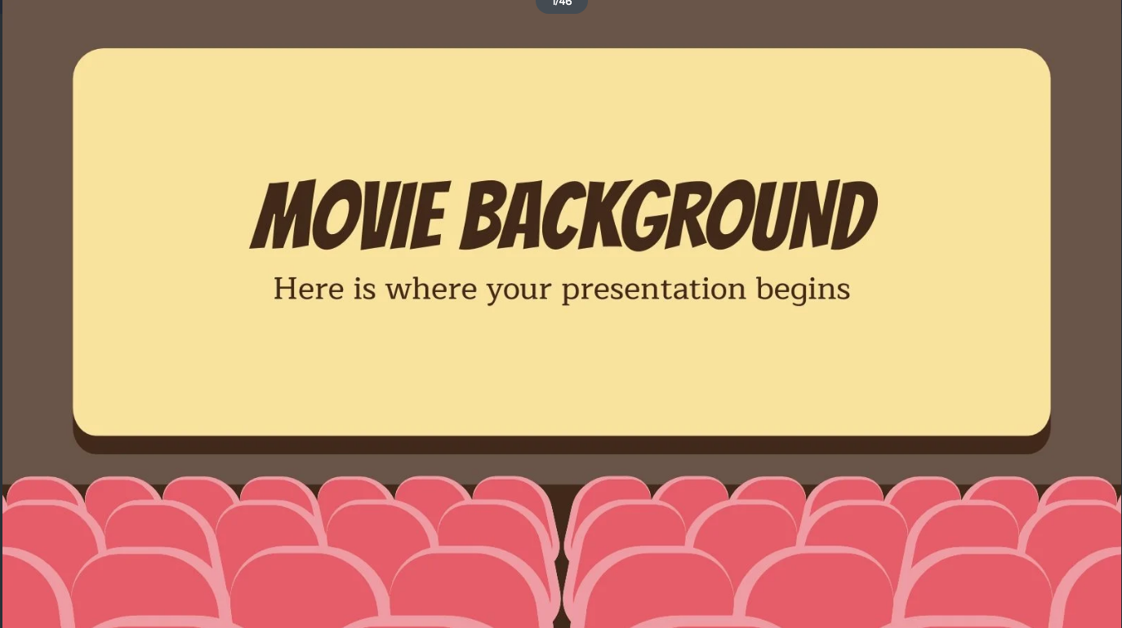


Back End Final Project
Movie Reservation API
By,
Christina Lytle

Slide 2
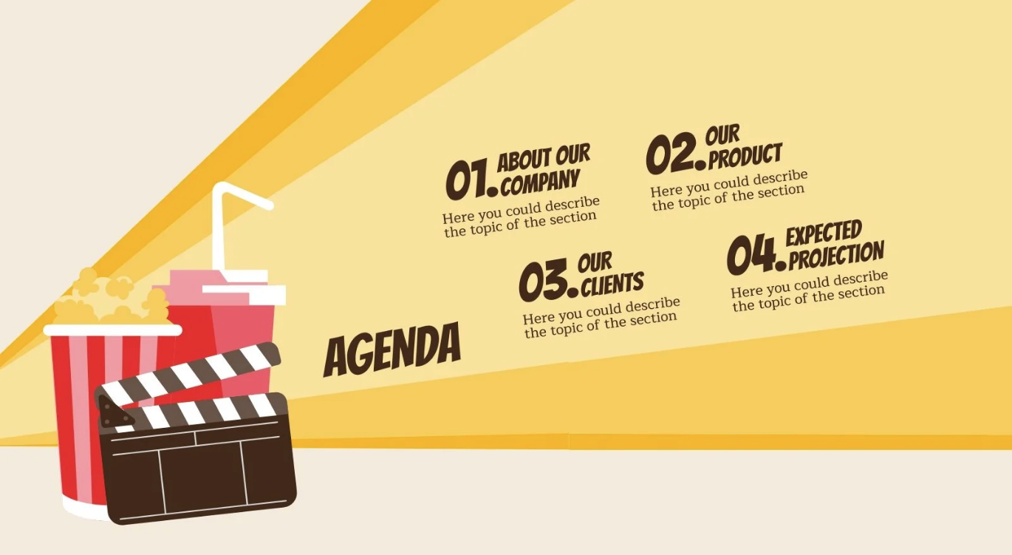
Customers will be able to:
Register and Login
Find a Screening that will have a movie, auditorium, and time
Select and reserve seats

Slide 3
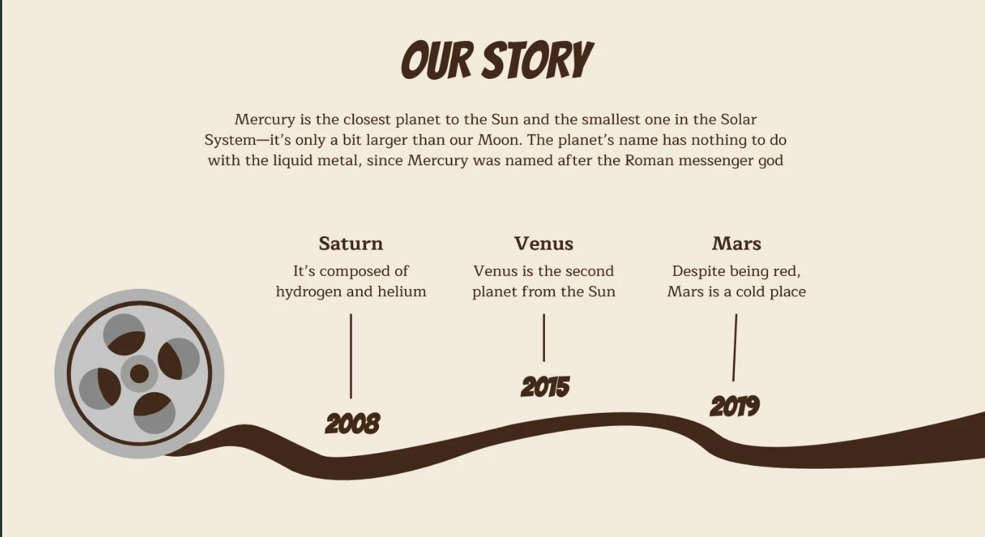
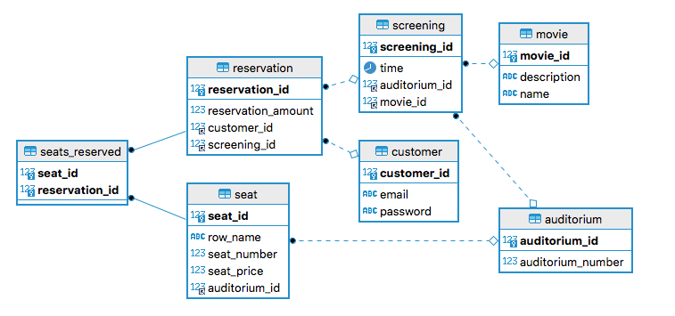
Entity Relationship Diagram

Slide 4

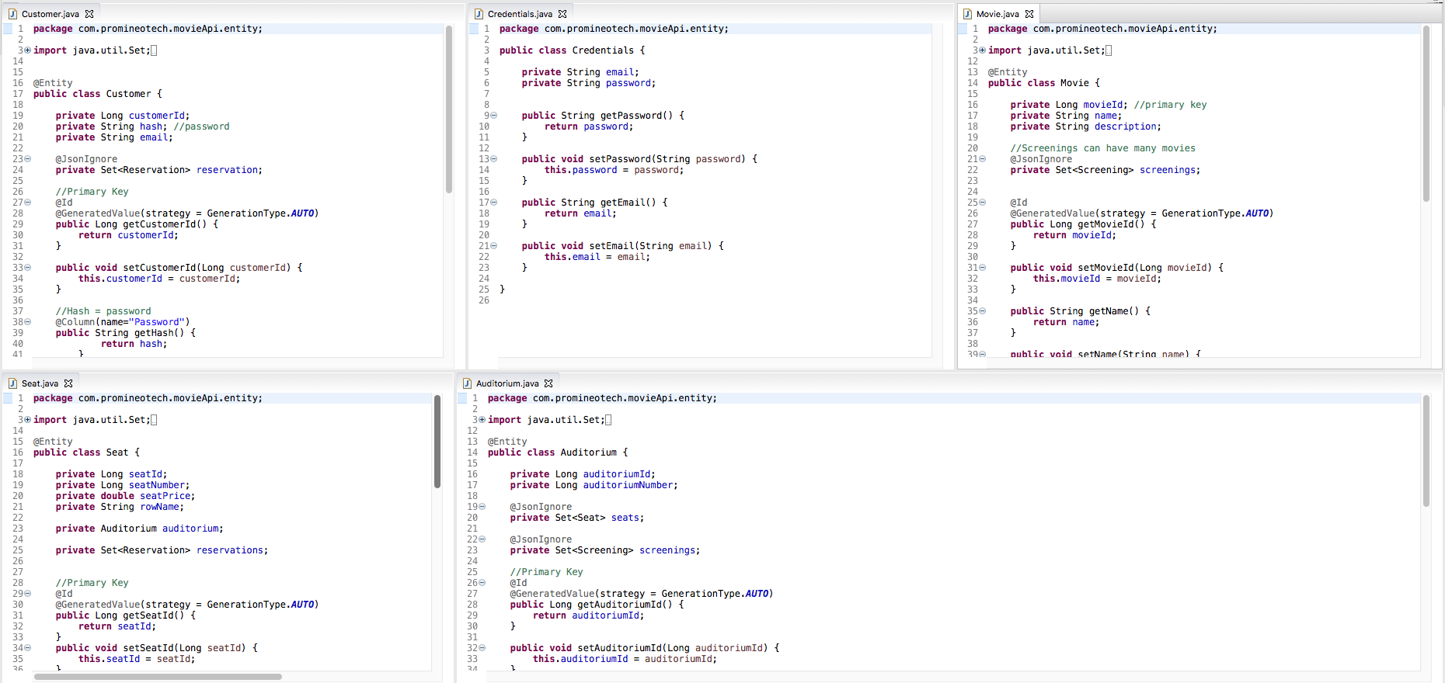
Entity Relationship Diagram
Entities
Customer/Credentials
Movie
Seat
Auditorium

Slide 5
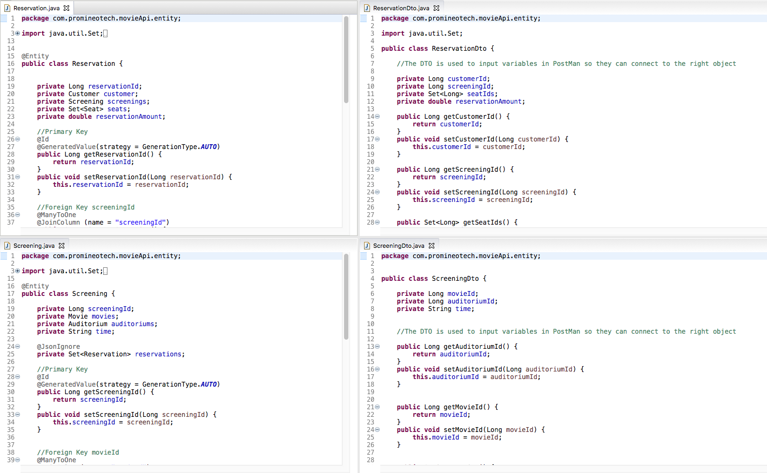
Entity Relationship Diagram
Entities Cont.
Reservation
Reservation DTO
Screening
Screening DTO

Slide 6
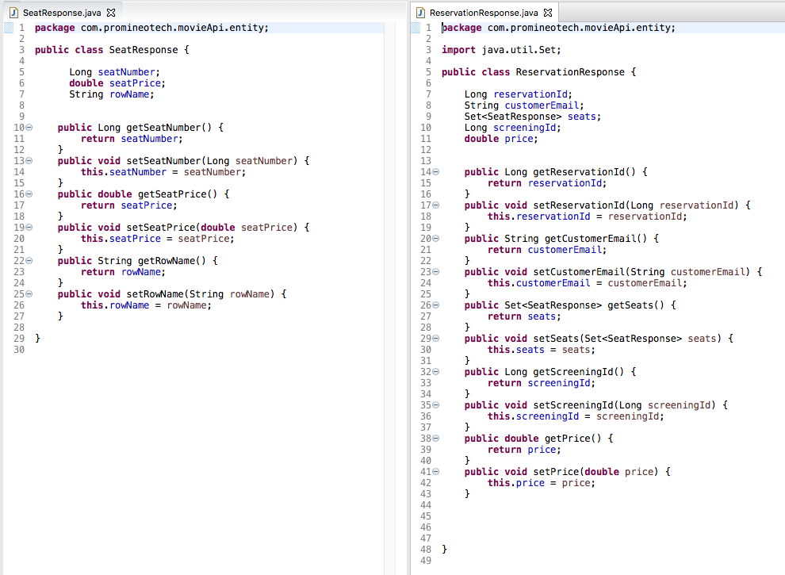
Entity Relationship Diagram
Entities Cont.
SeatResponse
ReservationResponse

Slide 7
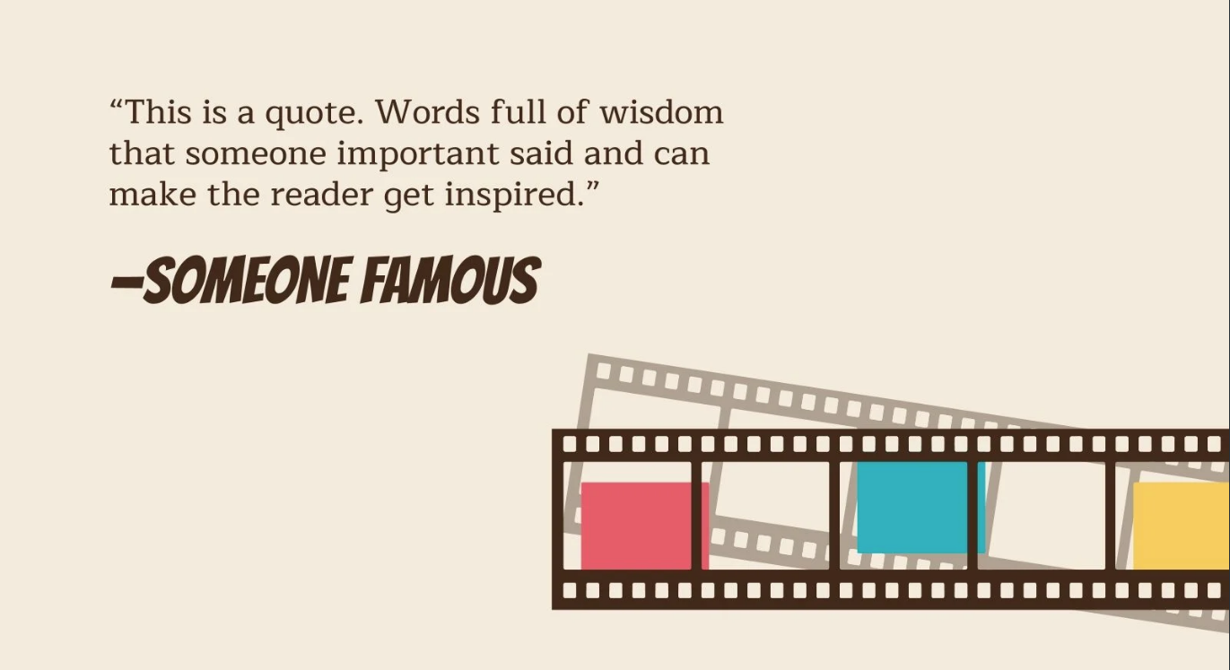
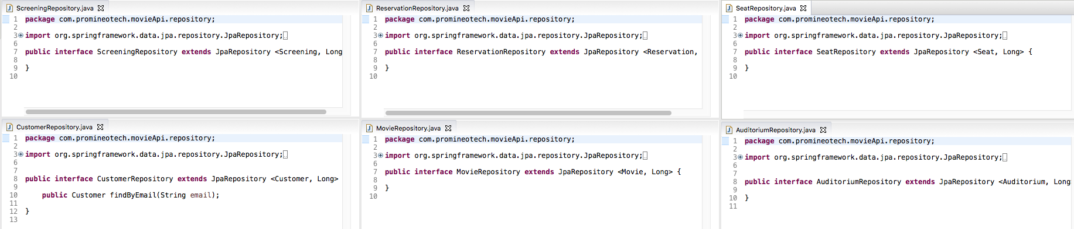
Repositories
ScreeningRepo
ReservationRepo
SeatRepo
CustomerRepo
MovieRepo
AuditoriumRepo

Slide 8
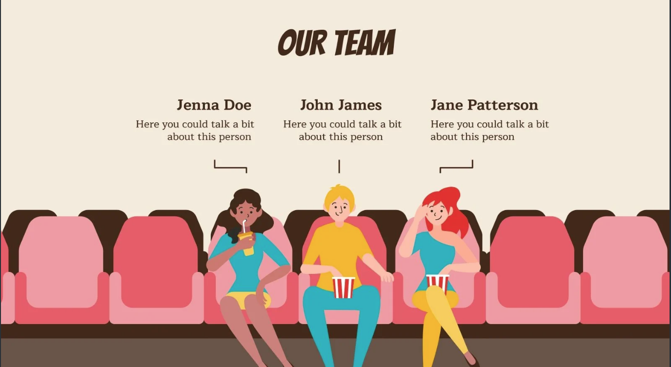
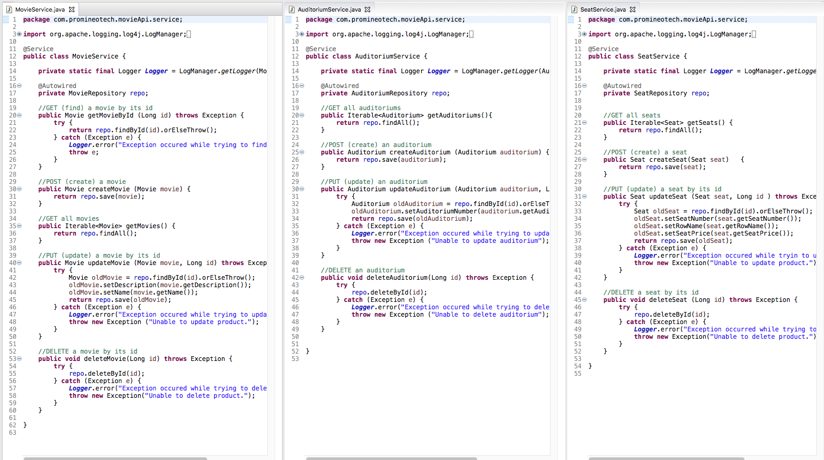
Services
Movie
Auditorium
Seat

Slide 9
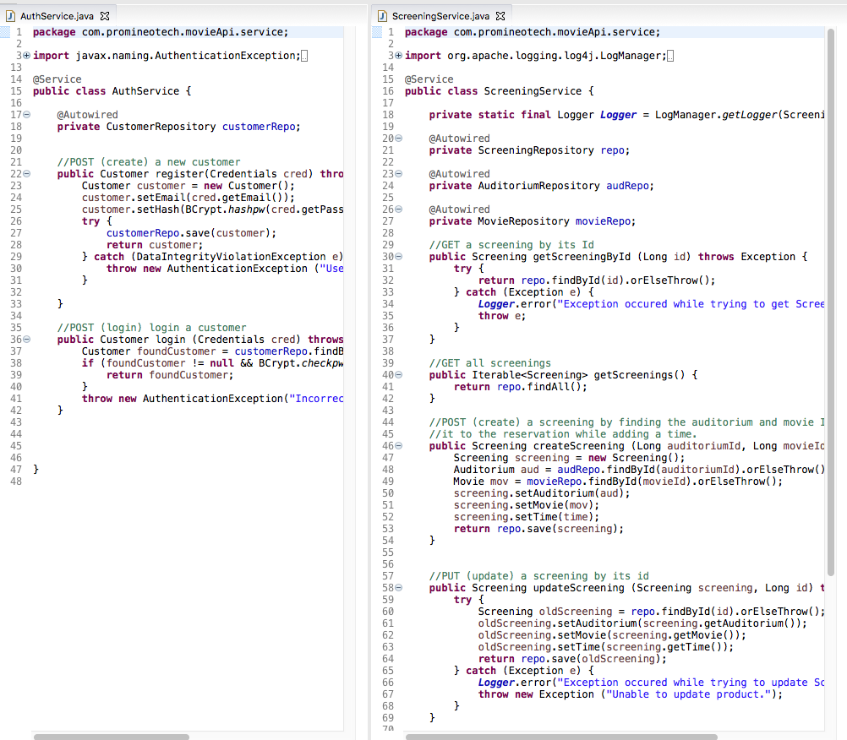
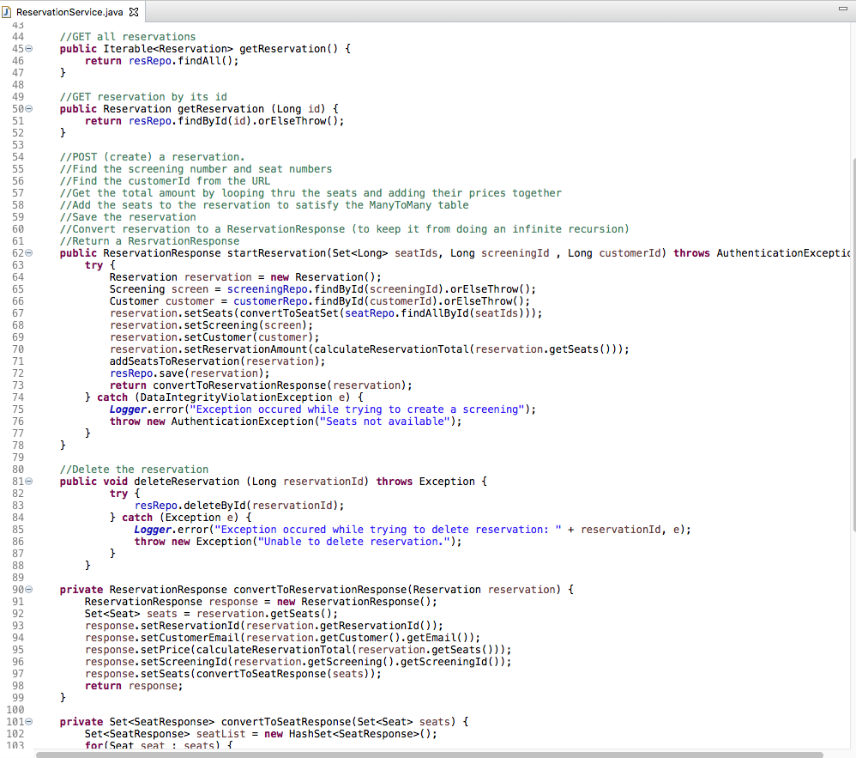
Services Cont.
Authority
Screening
Reservation

Slide 10
Services Cont.
I was getting an infinite JSON recursion problem, so I had to create a new Entity and convert Reservation to ReservationResponse so PostMan would return just the items I wanted to see.
Reservation

Slide 11
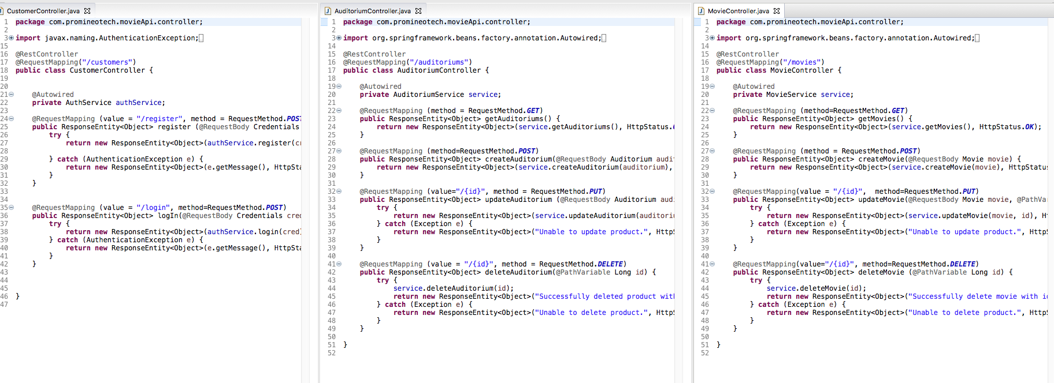
Controllers
Customer
Auditorium
Movie

Slide 12
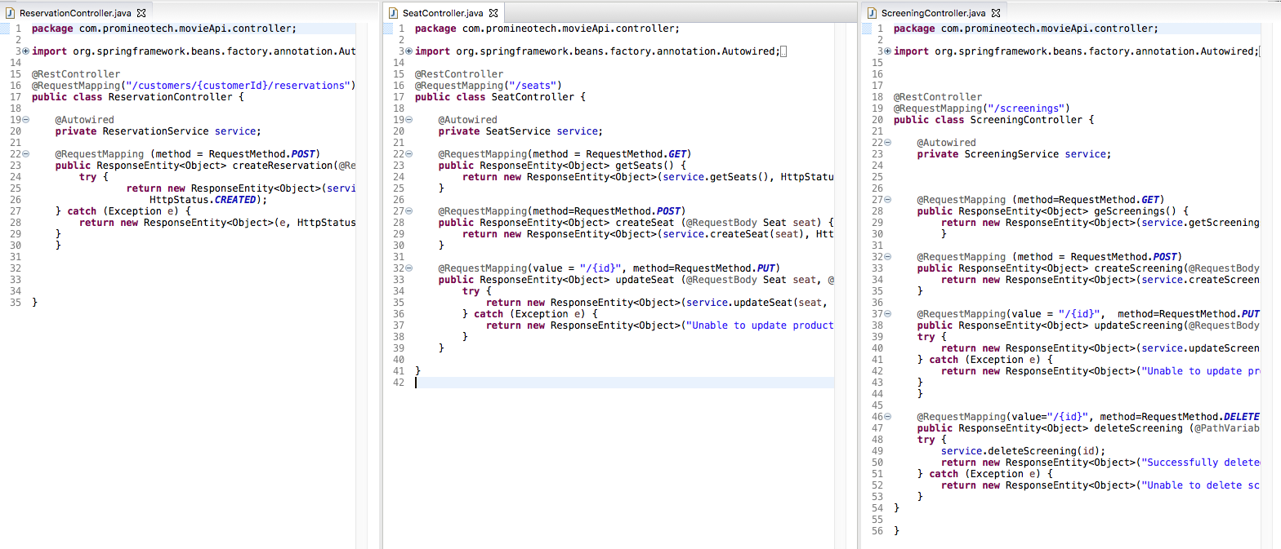
Controllers Cont.
Reservation
Seat
Screening

Slide 13
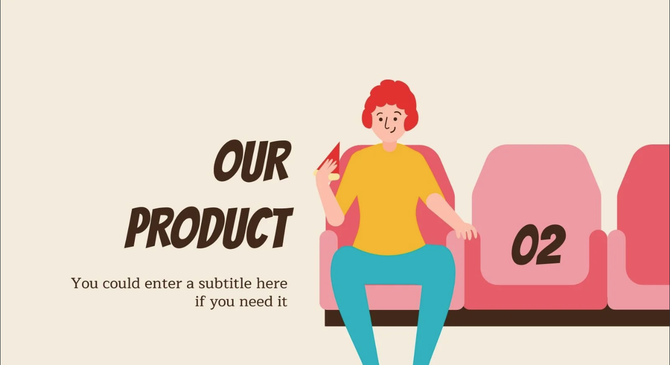
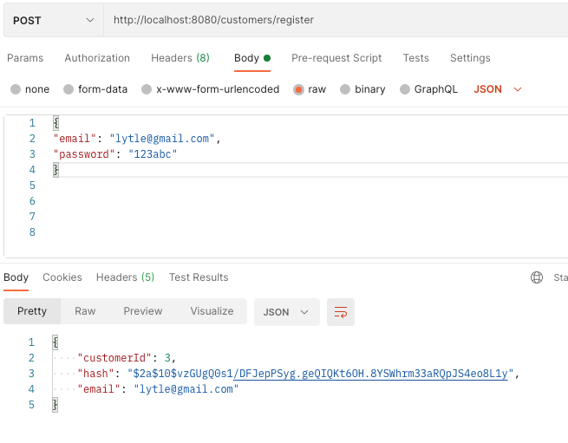
PostMan
Registering a Customer

Slide 14
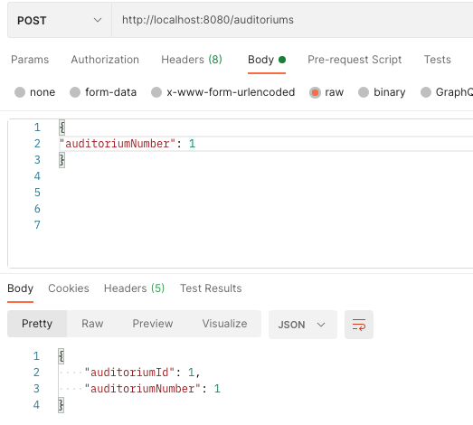
PostMan
Creating (POST) an auditorium

Slide 15
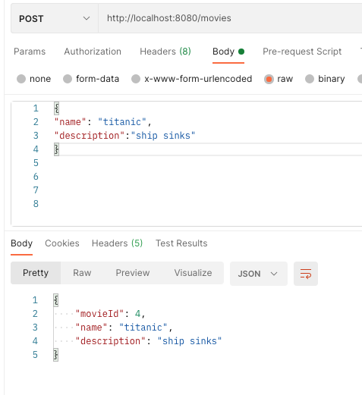
PostMan
Creating (POST) a Movie

Slide 16
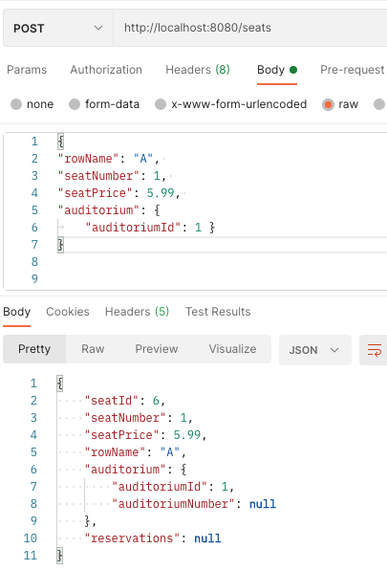
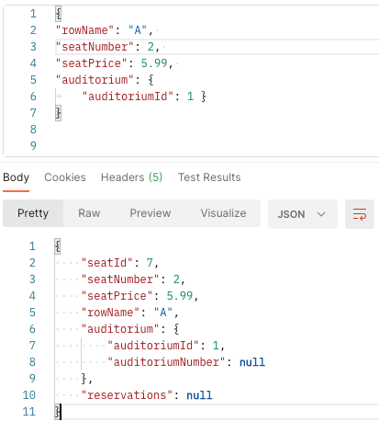
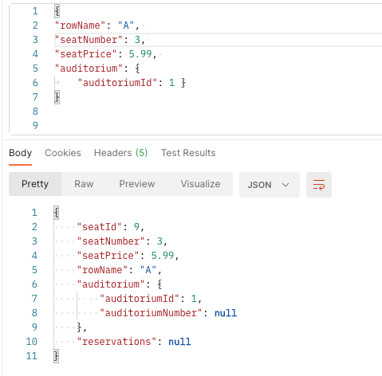
PostMan
Creating (POST) seats

Slide 17
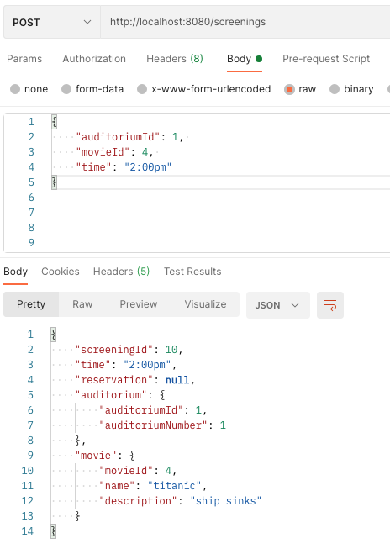
PostMan
Creating (POST) a Screening

Slide 18
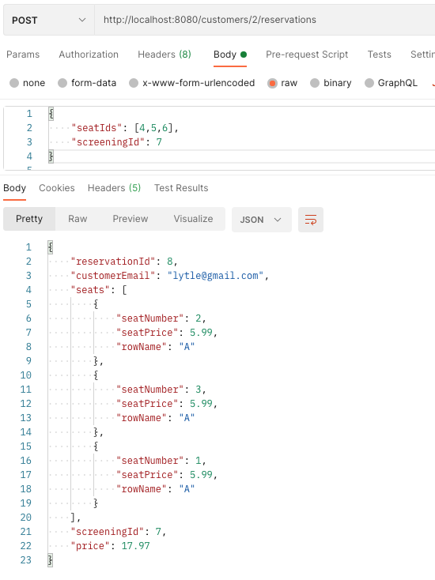
PostMan
Creating (POST) a Reservation

Slide 19

On My Way!
These past few months have been an incredible learning experience. There were many times I wanted to quit, but I knew that I had to keep going. I have learned so much, and can’t wait to keep learning and practicing.
My MovieAPI is in a good place, but there is still fine tuning but I am so proud of myself for building this from the the ground up and pushing myself to create something hard.
I hope to continue to learn Java and SQL, and hopefully work on becoming a Data Developer. I really enjoyed SQL and hope to dive deeper into it.

